Slide 1
MAAN App Introduction
MAAN App – Live Session
2019-02-25 | Bonn | Germany

Slide 2
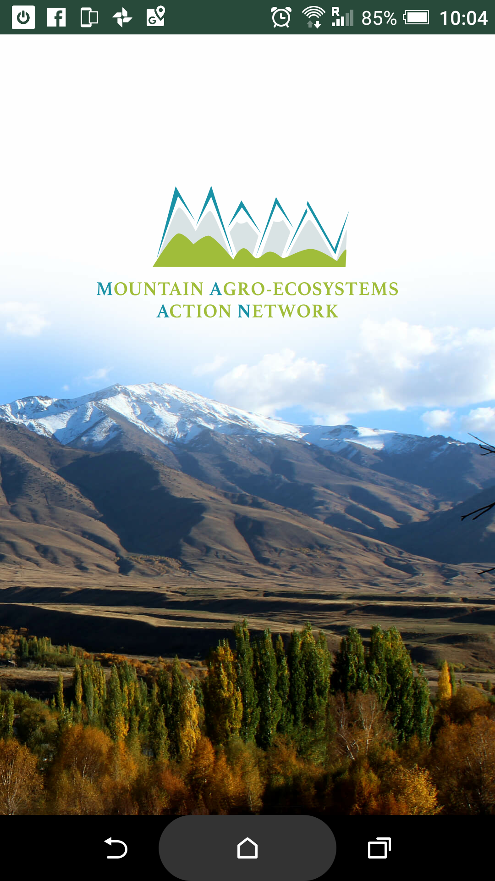
Welcome
1 Introduction
  Differences between browser & app version
  How to install
2 Quick tour through the app
3 Feedback, questions & answers

Slide 3
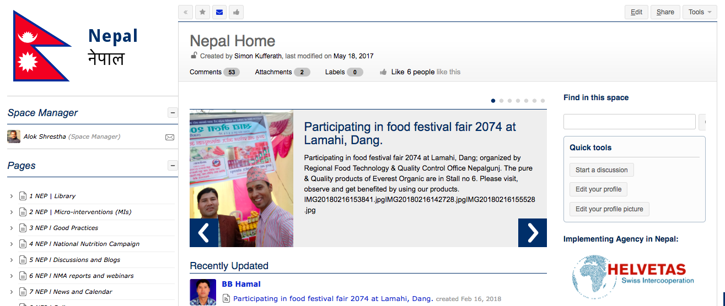
Website vs. App
Website:
Lots of functionality
Works best on a computer
Read & Edit all content
High bandwidth needs

Slide 4
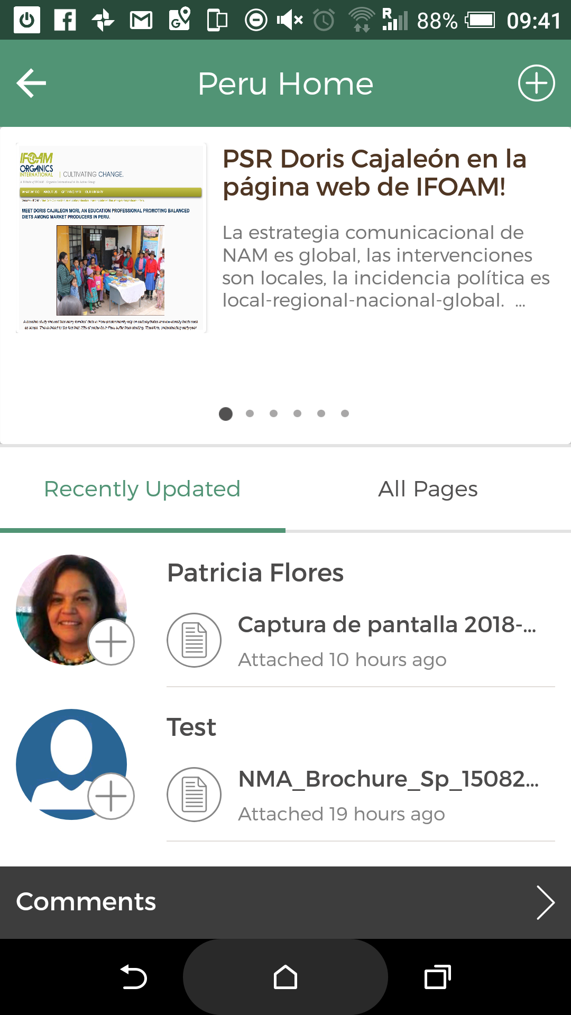
Website vs. App
App:
Simplified interface
Low bandwidth needs
Read + Text only + simple add blog/page/ attachments
Chat feature

Slide 5
How to Install
Direct link: MAAN App on Google Play
Open Google Play Store
Search for „maan ifoam“
Install
Have your username+password at hand to sign in

Slide 6
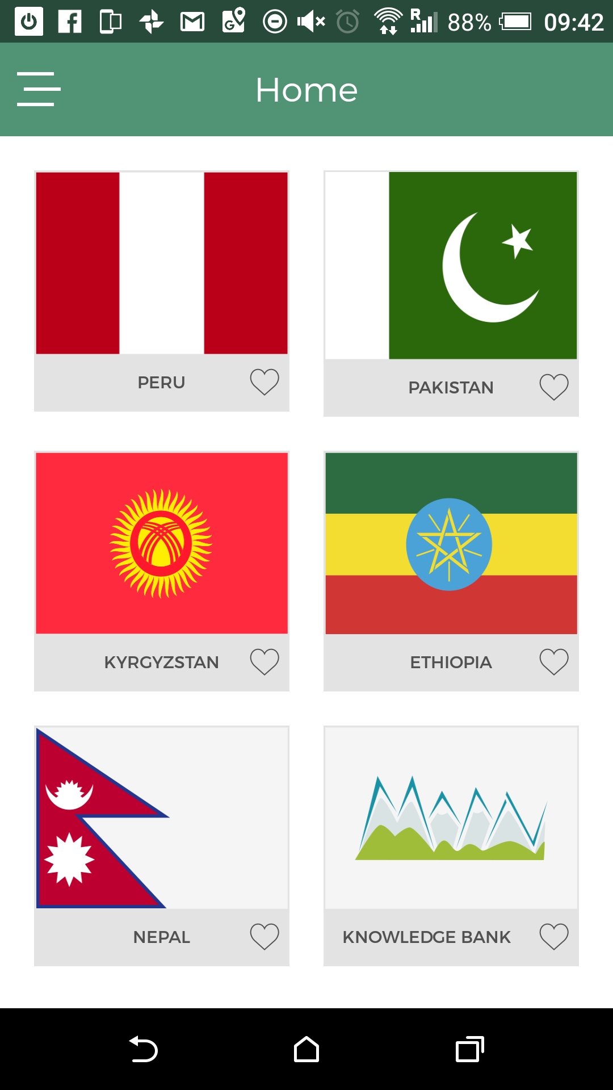
Screenshots

Slide 7
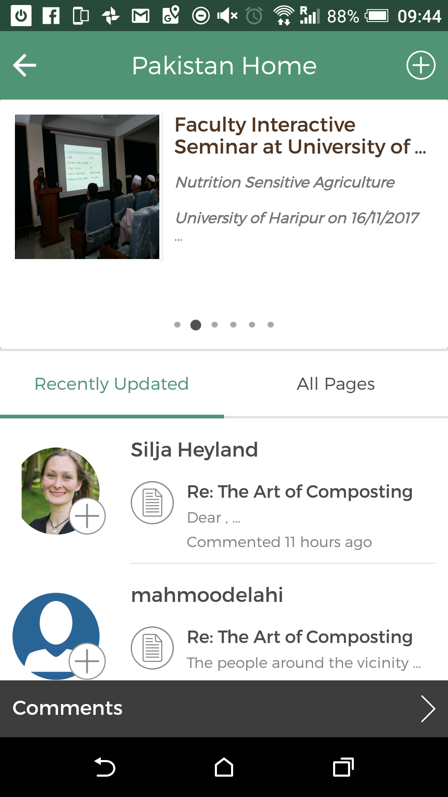
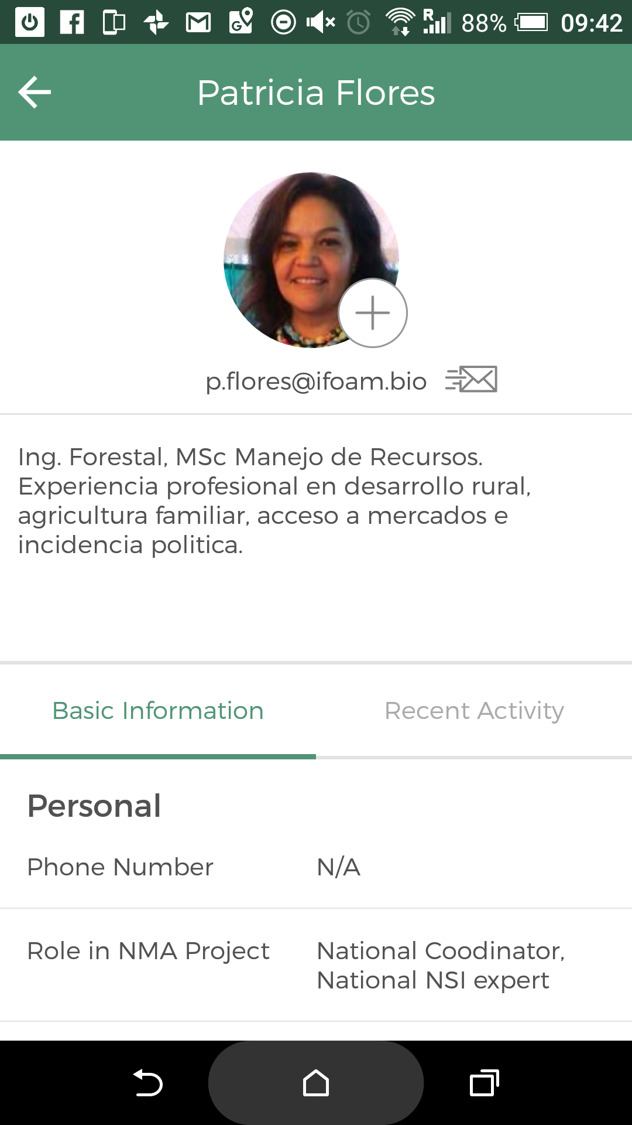
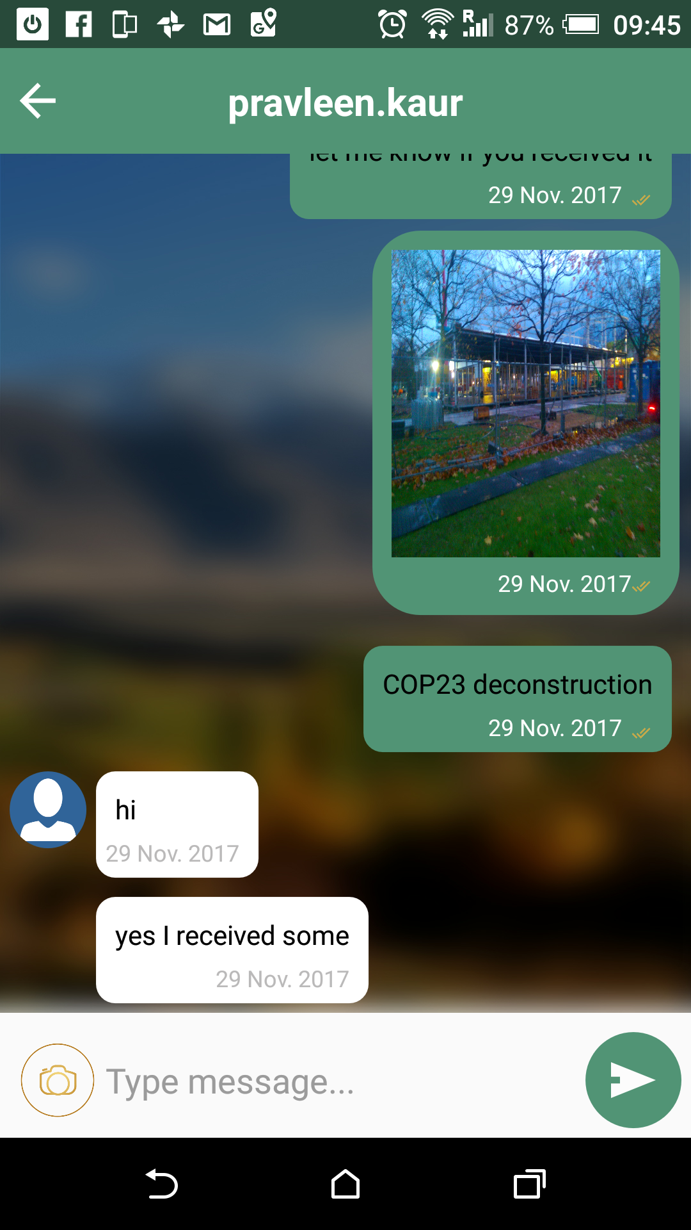
Screenshots

Slide 8
s.kufferath@ifoam.bio

