Slide 1
Welcome To
Organic Farming-Nutrition Sensitive Agriculture
Location:
Soha, Kacchi Beer Union Council District Haripur

Slide 2
Expected Main Results
A- Promoted healthy / rich food crops with low external input
farming practices to overcome malnutrition and
micronutrients deficiencies and ensure healthy environment
for agriculture
B-Promoted Organic Farming System with self operating farmers
and up-scaling through Farm Services Center
C-Increased scope of biological nourishment in crop nutrition
through leguminous crops, green manures, composts of
extraneous organic materials, FYM and chicken manure,
urban waste, slaughter house byproducts , sugar mill pressed mud.
etc.

Slide 3
Activities Completed
1-Inception Phase:
-Baseline Survey………………………………………….Rs: 5,000
-Awareness raising sessions with farmers
(male & female) 5x2,000……………………………Rs: 10,000
-Compost making trainings 3x40,000………..Rs: 120,000
-Application Methodology / practical
display 3x 10,000……………………………………….Rs: 30,000
-Establish Compost making sites 3x5,000….Rs: 15,000
-Production of EIC material……………………….Rs: 20,000

Slide 4
Summary of completed works
Sr.# | Name of activity | Village / Location | Direct Participa Beneficiaries | Household benefitted | Indirect Beneficiaries | Date of completion
1 | Baseline Survey Women(MDDS) Focus Group Discussion | Soha Chbraki Sar Kacchi Sar Kachi | 10 women 10 women 21 women | 10 women 10 women 21 | - - - | 18.05.016 20.05.016 24.05.016
2 | Awareness Raising Sessions five No: Awareness Session Awareness Session Awareness Session Awareness Session 5. Awareness Session | Sar Kacchi Sar Kacchi Soha Kacchi Khalason Chinjiala Cum Kacchi | 19 male 19 female 14 male 19 female 16 male | 19 HH 19 HH 14 HH 19 HH 16 HH | 125 125 92 125 106 | 03.06.016 03.06.016 04.06.016 19.07.016 21.07.016
3 | Compost making Training / display 3 # Compost makingTraining /display Compost makingTraining / display Compost making Training / display | Sar Kacchi Chinjiala Cum Kacchi Soha | 21 male 21 male 21 male | 21 HH 21 HH 21 HH | 140 140 140 | 12th & 13th 2016 27th & 28th 2016 21st & 22nd 2016
4 | Establishment of Compost making sites Compost making Site in the land of Babar Khan Compost making Site in the land of Haroon Compost making Site in the land of Muhammad Irshad | Zain Kacchi Chinjiala Cum Kacchi Soha | 1 male 1 male 1 male | 1 HH 1 HH 1 HH | 7 8 8 | 30.07.2016 30.07.2016 04.11.2016
Summary of completed works:

Slide 5
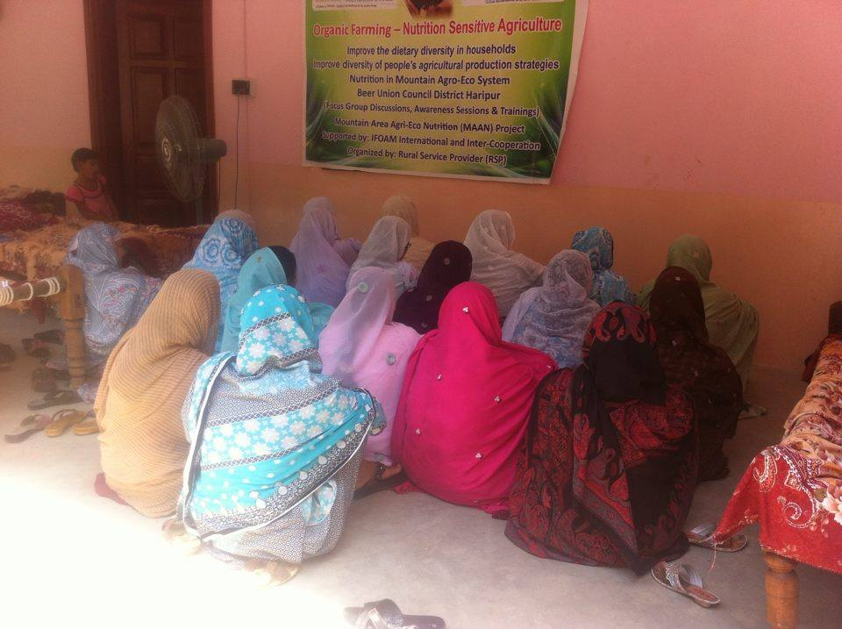
Notes:
Baseline Survey-Group Discussion at village Sar Kacchi -24th May 2016

Slide 6
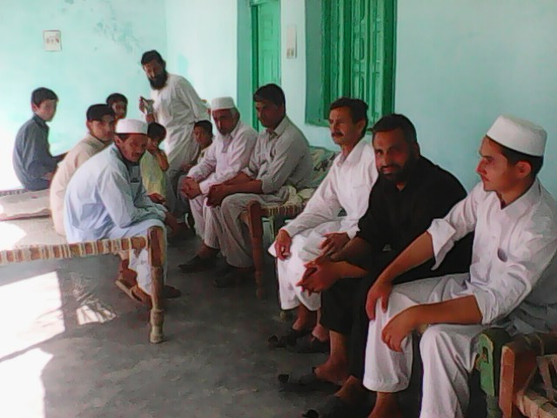
Notes:
1. Awareness Session male-at Sar Kacchi Beer Union Council – 3rd June 2016

Slide 7
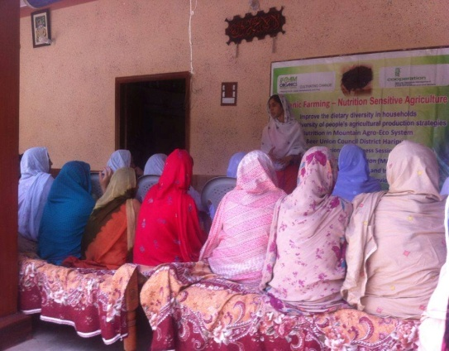
Notes:
2. Awareness Session Female-at Sar Kacchi Beer Union Council-3rd June 2016

Slide 8
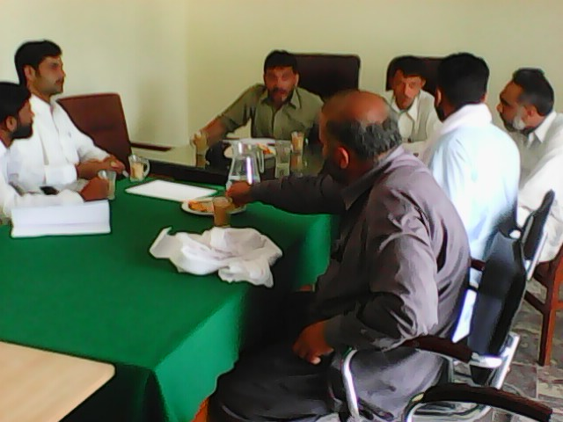
Notes:
3. Awareness Session male at village Council Office Soha-4th June 2016

Slide 9
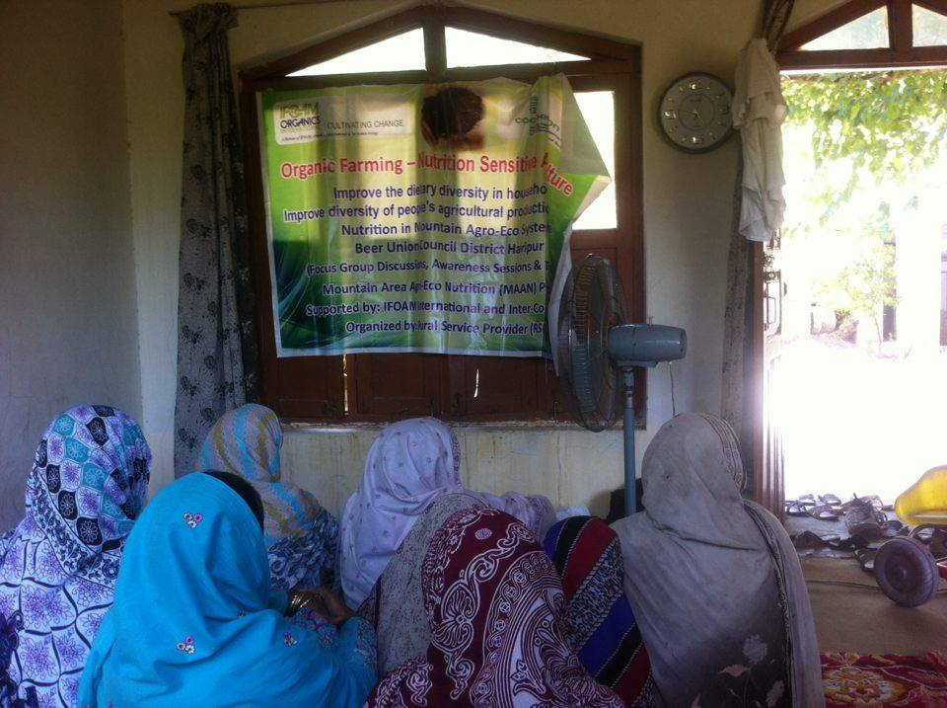
Notes:
4. Awareness Raising Session Female at village Kacchi Khalosan dated 19th July 2016

Slide 10
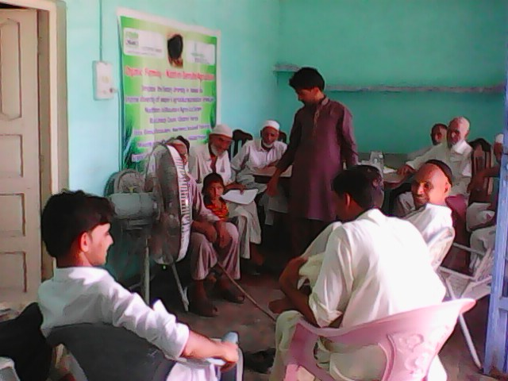
Notes:
5. Awareness Session Male at village Chanjiala cum Kacchi- dated 21st July 2016

Slide 11
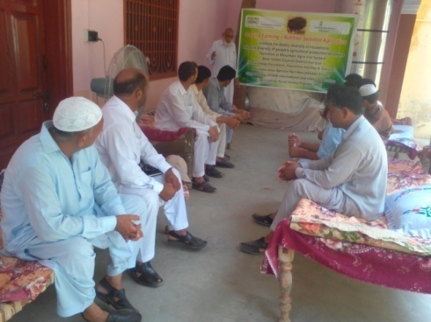
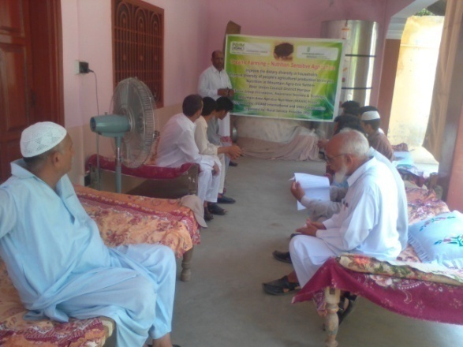
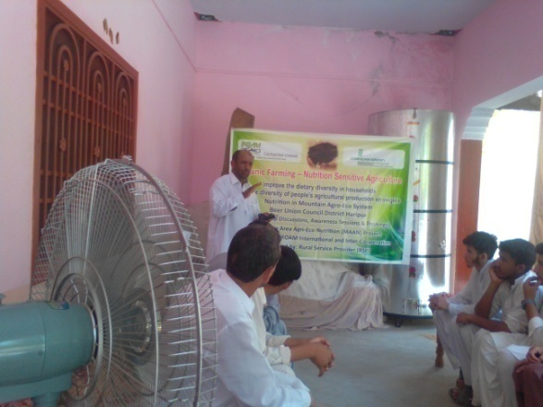
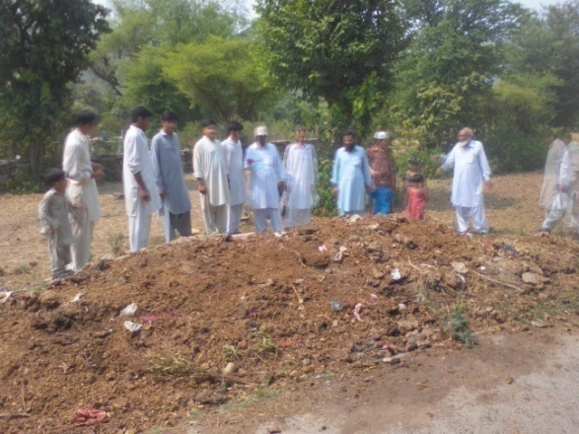
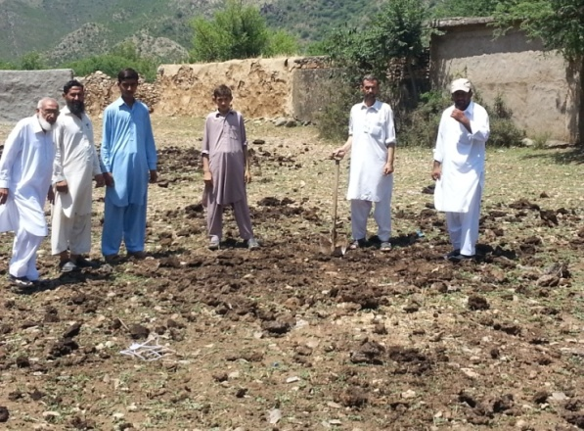
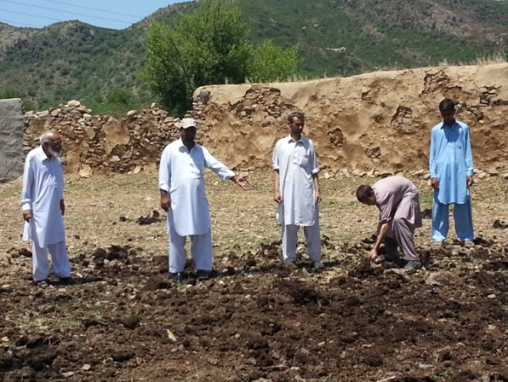
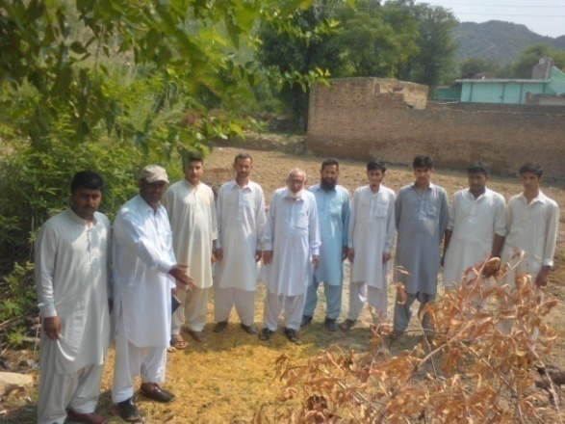
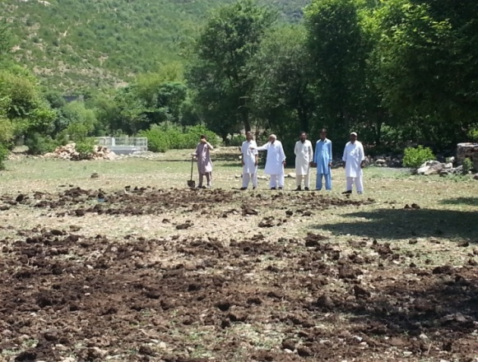
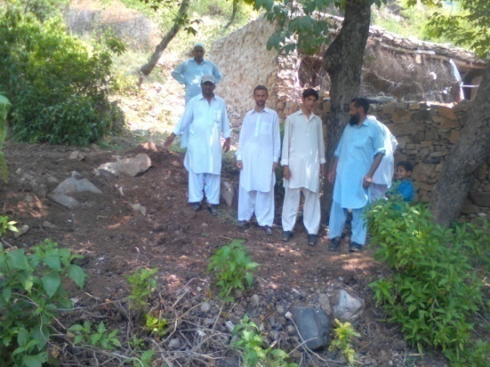
Training Session-Welcome address & Introduction of MAAN Project at village Sar Kachi Beer UC dated 12th July 2016
Notes:
1. Compost making Training at village Sar Kacchi on dated 12th and 13th July 2016

Slide 12
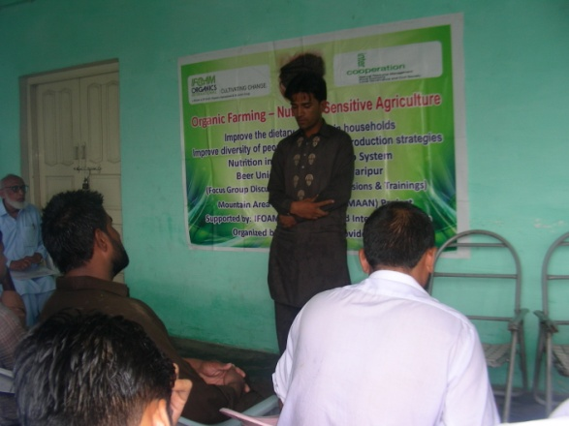
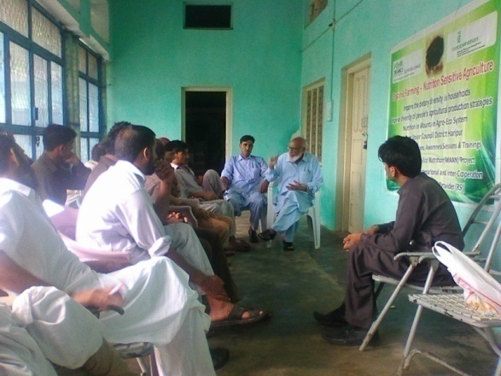
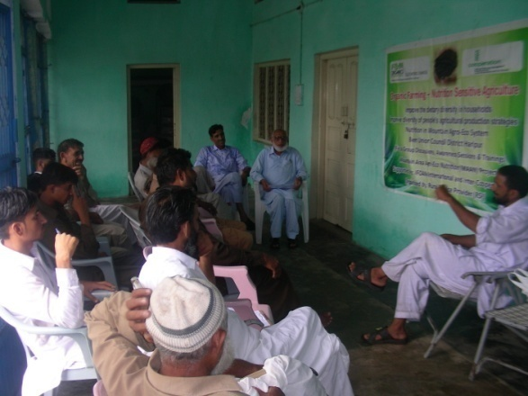
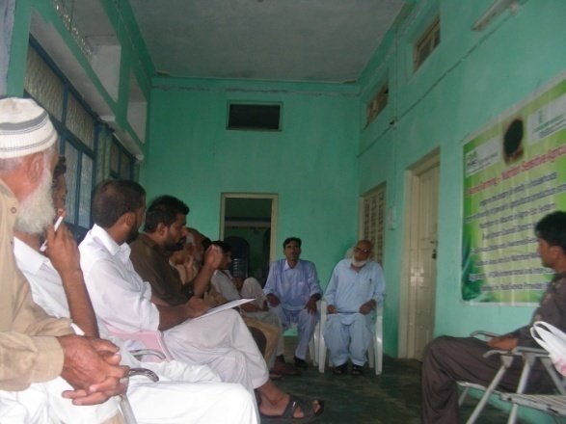
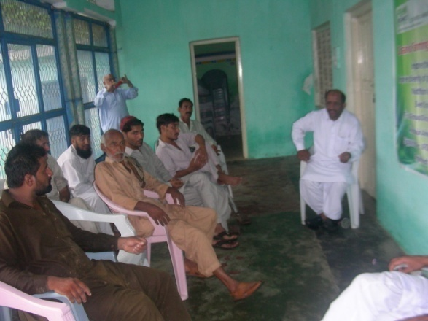
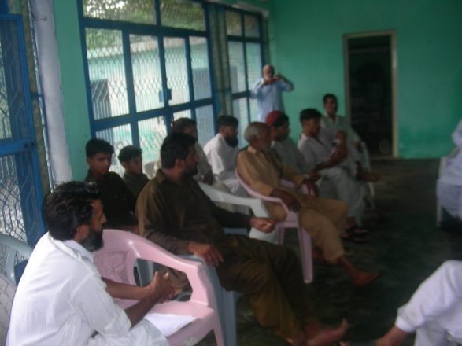
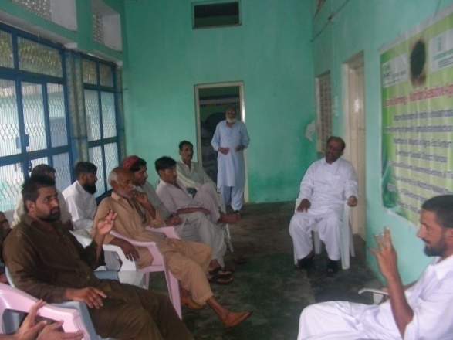
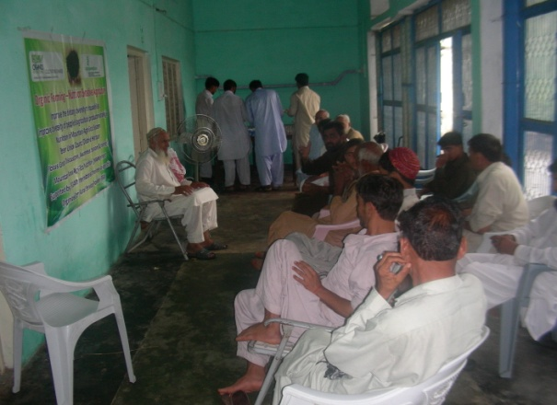
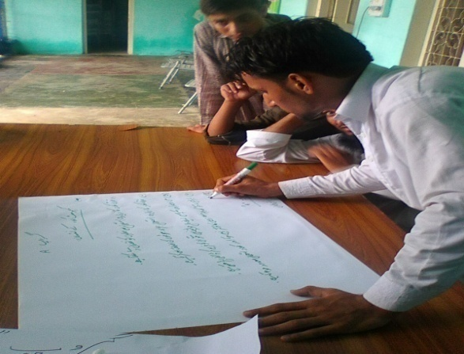
Notes:
2. Compost making Training at village Chinjiala cum Kacchi on dated 27th and 28th July 2016

Slide 13
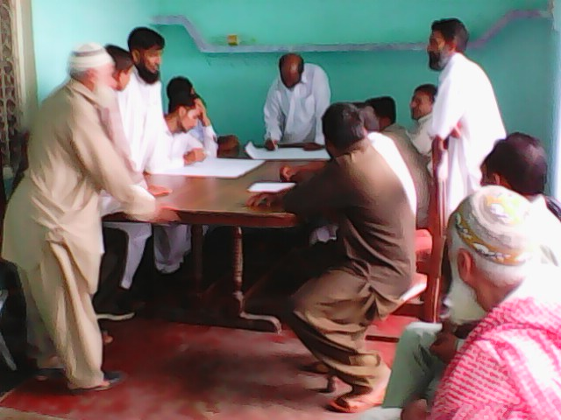
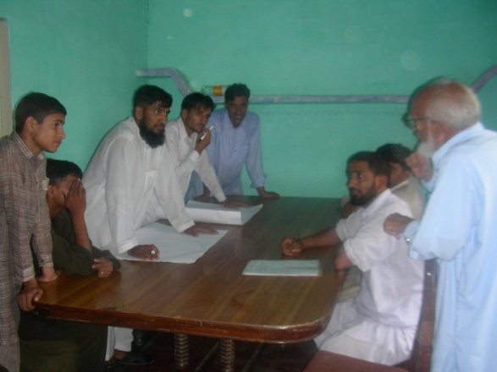
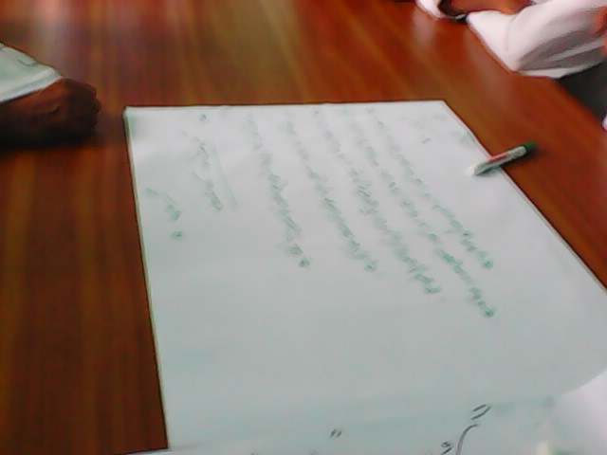
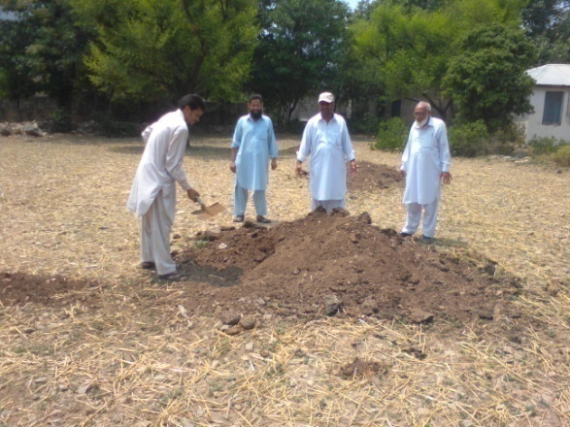
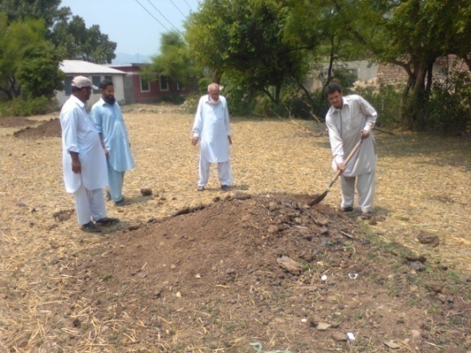
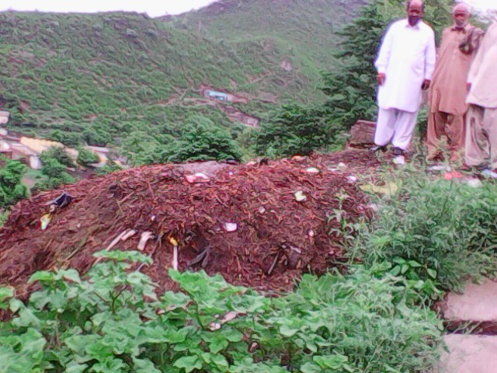
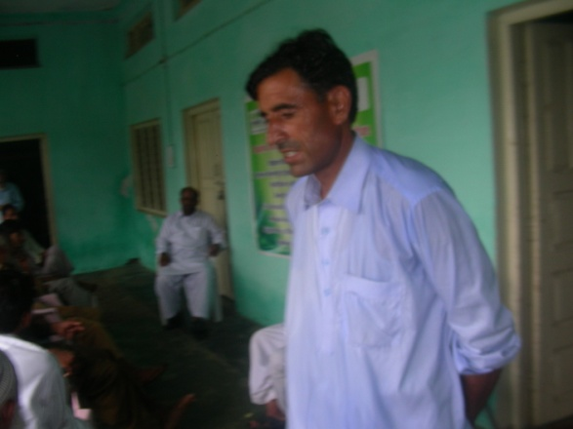
Notes:
Contnued- Compost making Training at village Chinjiala cum Kacchi on dated 27th and 28th July 2016

Slide 14
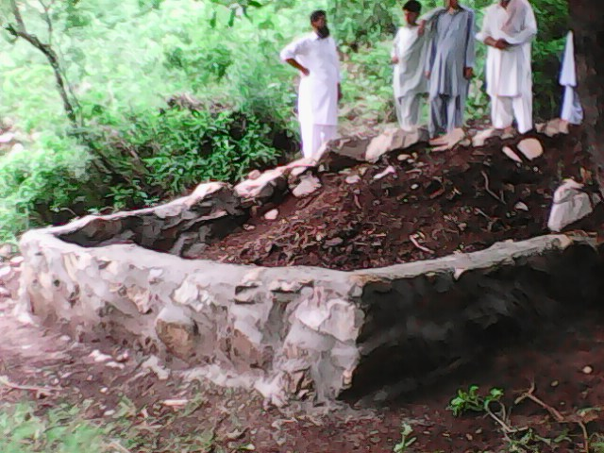
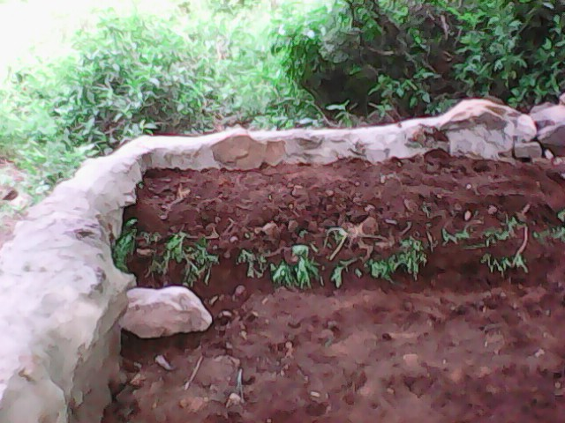
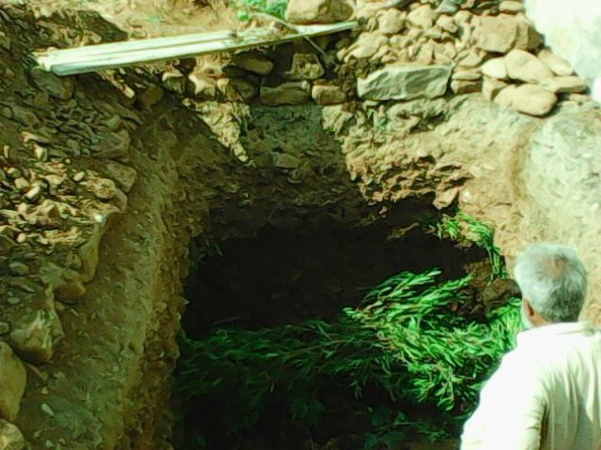
Notes:
Compost making site at village Zain Kacchi dated 30th July 2016

Slide 15
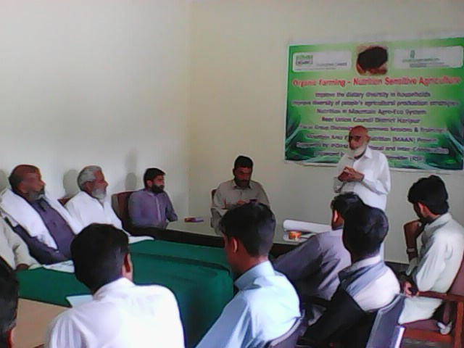
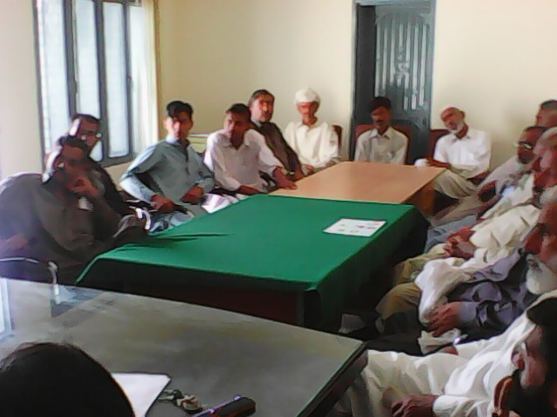
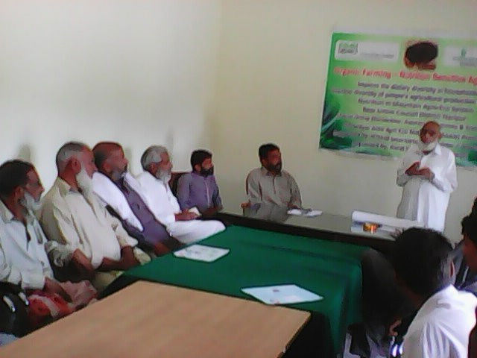
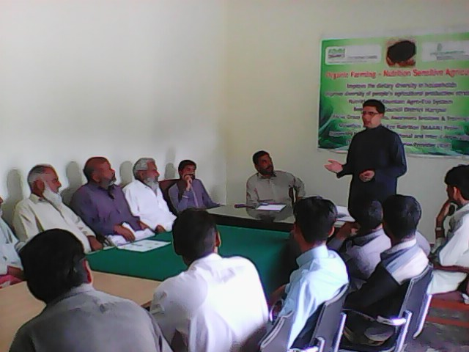
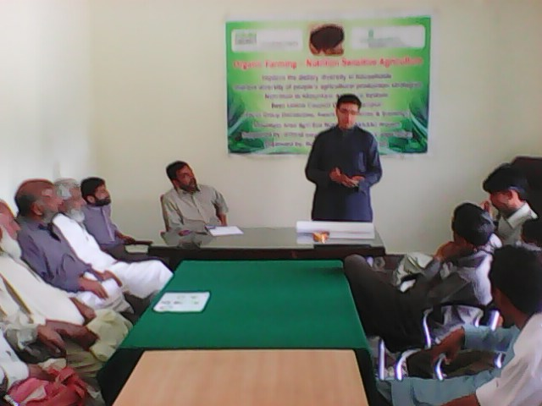
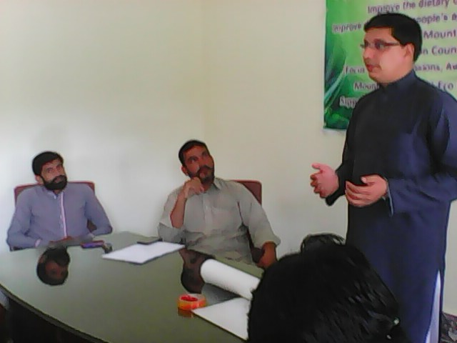
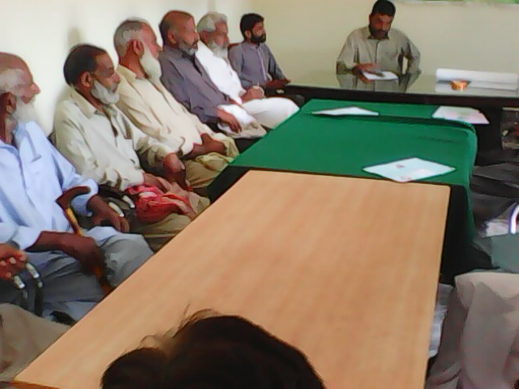
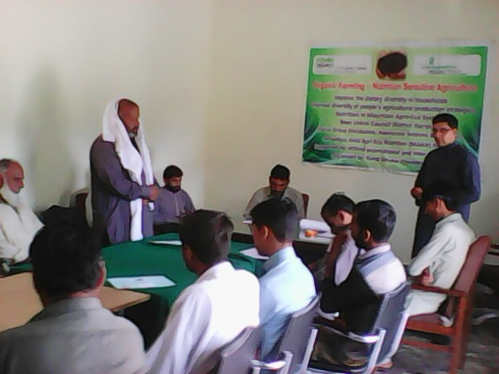
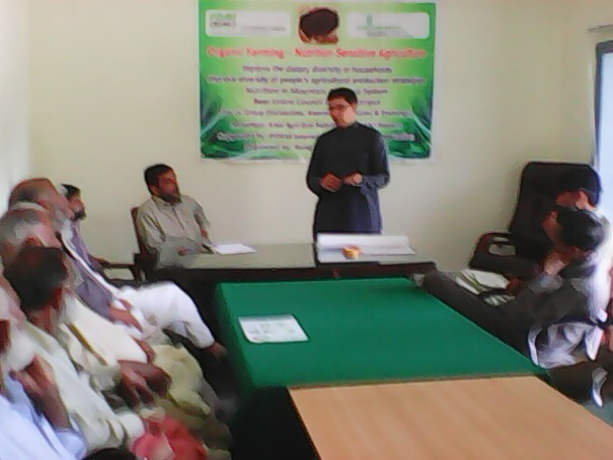
Notes:
3. Compost Making Training at Village Soha Beer Union Council- dated 21st and 22nd October 2016

Slide 16
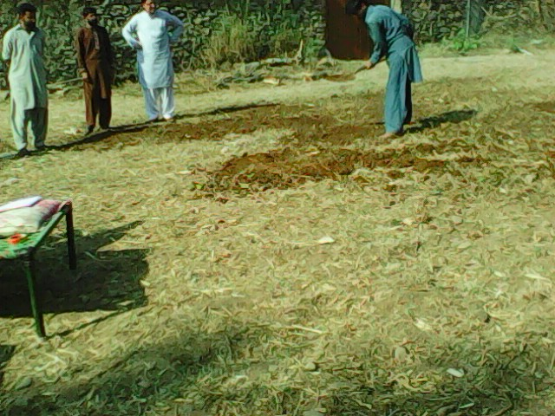
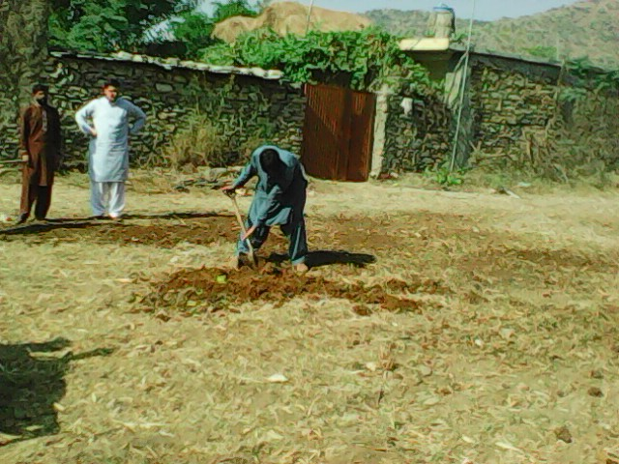
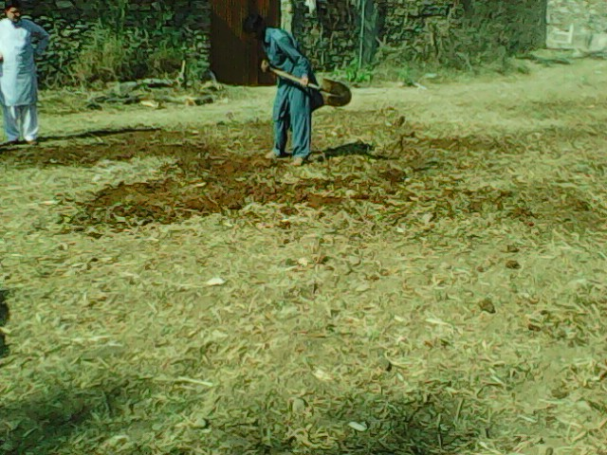
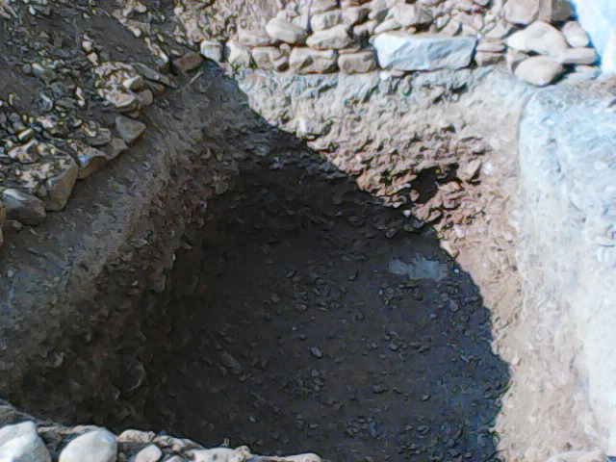
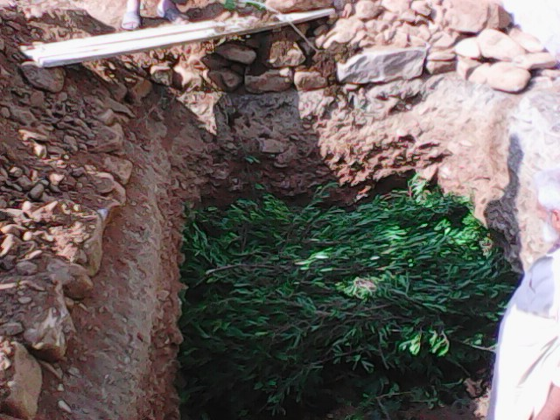
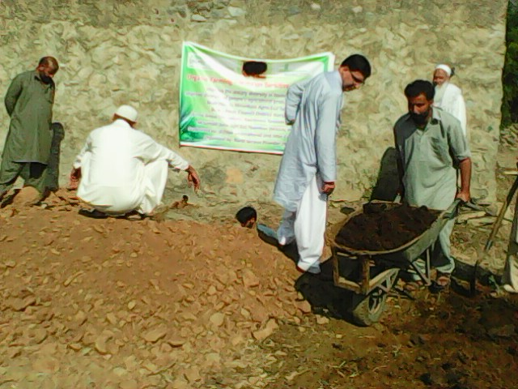
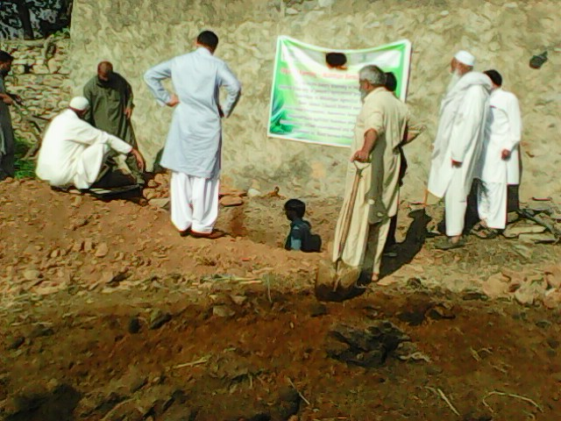

Notes:
Continued-Compost Making Training / Display at Village Soha Beer Union Council- dated 21st and 22nd October 2016

Slide 17







Notes:
Continued-Compost Making Training / Display at Village Soha Beer Union Council- dated 21st and 22nd October 2016

