Slide 1
Welcome To
Organic Farming-Nutrition Sensitive Agriculture
Location:
Soha, Kacchi Beer Union Council District Haripur
Notes:
Updated version

Slide 2
Expected Main Results
A- Promoted healthy / rich food crops with low external input
farming practices to overcome malnutrition and
micronutrients deficiencies and ensure healthy environment
for agriculture
B-Promoted Organic Farming System with self operating farmers
and up-scaling through Farm Services Center
C-Increased scope of biological nourishment in crop nutrition
through leguminous crops, green manures, composts of
extraneous organic materials, FYM and chicken manure,
urban waste, slaughter house byproducts , sugar mill pressed mud.
etc.

Slide 3
Activities Completed
1-Inception Phase:
-Baseline Survey………………………………………….Rs: 5,000
-Awareness raising sessions with farmers
(male & female) 5x2,000……………………………Rs: 10,000
-Compost making trainings 3x40,000………..Rs: 120,000
-Application Methodology / practical
display 3x 10,000……………………………………….Rs: 30,000
-Establish Compost making sites 3x5,000….Rs: 15,000
-Production of IEC material……………………….Rs: 20,000

Slide 4
Summary of completed works
Sr.# | Name of activity | Village / Location | Direct participant Beneficiaries | Household benefitted | Indirect Beneficiaries | Date of completion
1 | Baseline Survey Women(MDDS) Focus Group Discussion | Soha Chbraki Sar Kacchi Sar Kachi | 10 women 10 women 21 women | 10 HH 10 HH 21 HH | - - - | 18.05.016 20.05.016 24.05.016
2 | Awareness Raising Sessions five No: Awareness Session Awareness Session Awareness Session Awareness Session 5. Awareness Session | Sar Kacchi Sar Kacchi Soha Kacchi Khalason Chinjiala Cum Kacchi | 19 male 19 female 14 male 17 female 16 male | 19 HH 19 HH 14 HH 17 HH 16 HH | 125 125 92 119 106 | 03.06.016 03.06.016 04.06.016 19.07.016 21.07.016
3 | Compost making Training / display 3 # Compost making Training /display Compost making Training /display Compost making Training /display | Sar Kacchi Chinjiala Cum Kacchi Soha | 21 male 21 male 21 male | 21 HH 21 HH 21 HH | 140 140 140 | 12th & 13th/7/2016 27th & 28th /7/2016 21st & 22nd /10/2016
4 | Establishment of Compost making sites Compost making Site in the land of Babar Khan Compost making Site in the land of Haroon Compost making Site in the land of Muhammad Irshad | Zain Kacchi Chinjiala Cum Kacchi Soha | 1 male 1 male 1 male | 1 HH 1 HH 1 HH | 7 8 8 | 30.07.2016 30.07.2016 04.11.2016
5 | Methodology/Compost making display Practical display Practical display Practical display | Soha Zaindi Kacchi Chinjiala | 15 male 15 male 15 male | 15 HH 15HH 15HH | 105 105 105 | 28.11.2016 29.11.2016 30.11.2016
Summary of completed works:
Notes:
Summary of Completed Works / Activities 160 M 77 F 237 HH 1325

Slide 5
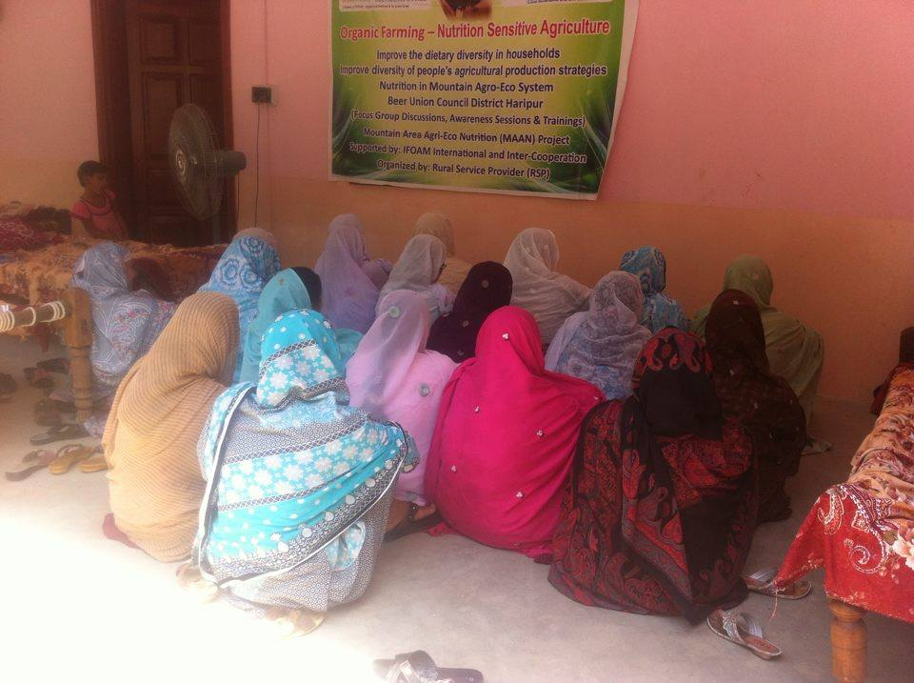
Notes:
Baseline Survey-Group Discussion at village Sar Kacchi -24th May 2016

Slide 6
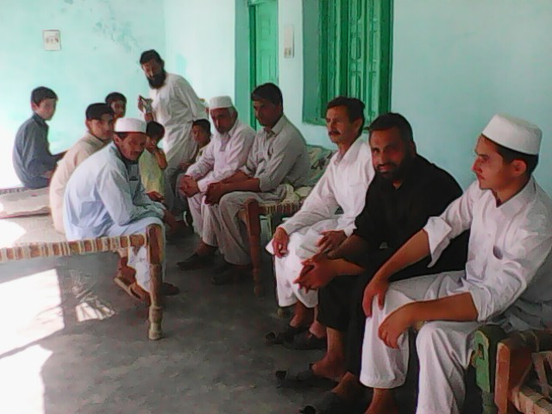
Notes:
1. Awareness Session male-at Sar Kacchi Beer Union Council – 3rd June 2016

Slide 7
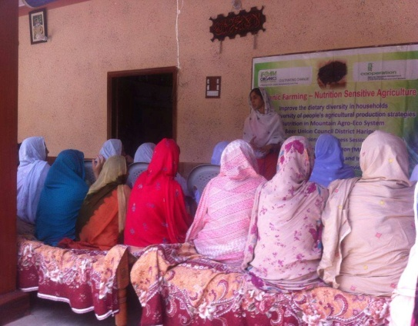
Notes:
2. Awareness Session Female-at Sar Kacchi Beer Union Council-3rd June 2016

Slide 8
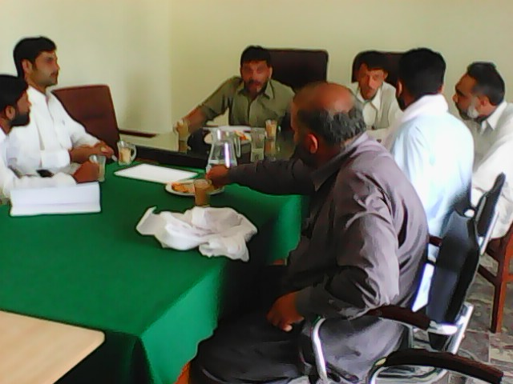
Notes:
3. Awareness Session male at village Council Office Soha-4th June 2016

Slide 9
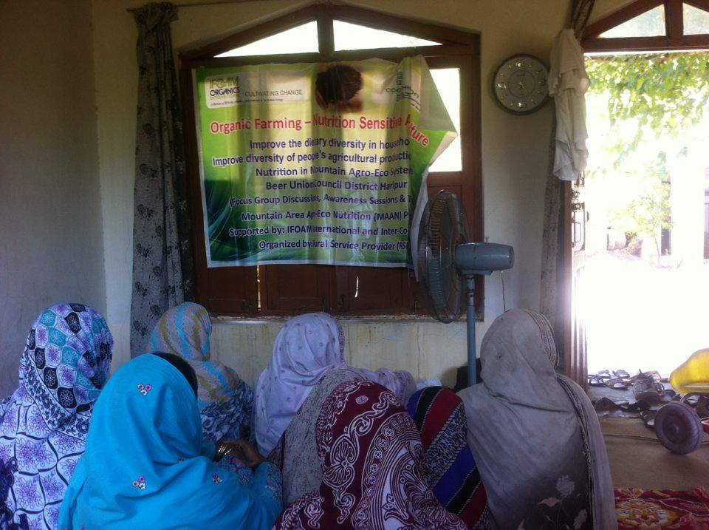
Notes:
4. Awareness Raising Session Female at village Kacchi Khalosan dated 19th July 2016

Slide 10
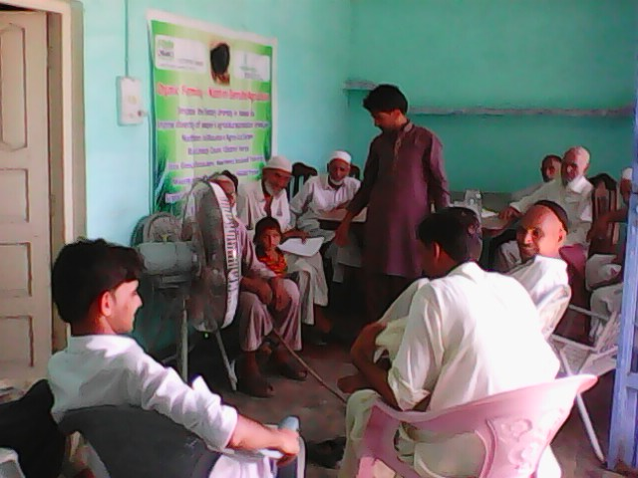
Notes:
5. Awareness Session Male at village Chanjiala cum Kacchi- dated 21st July 2016

Slide 11
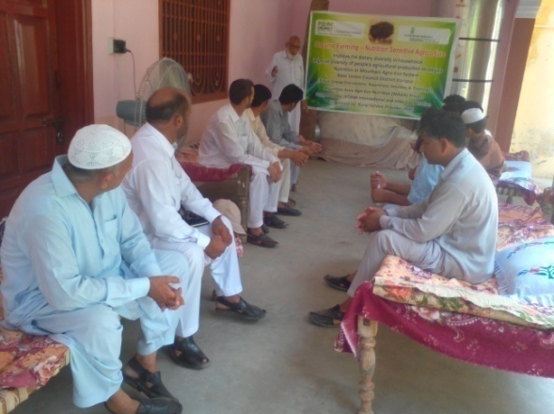
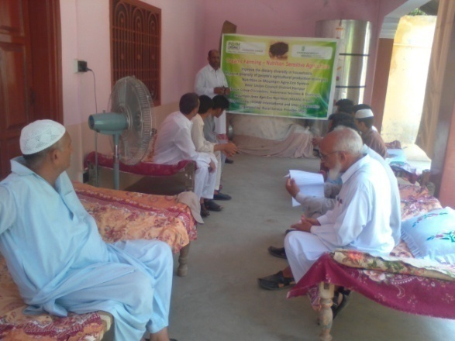
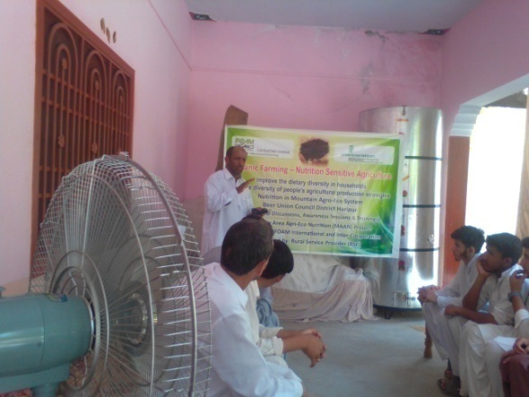
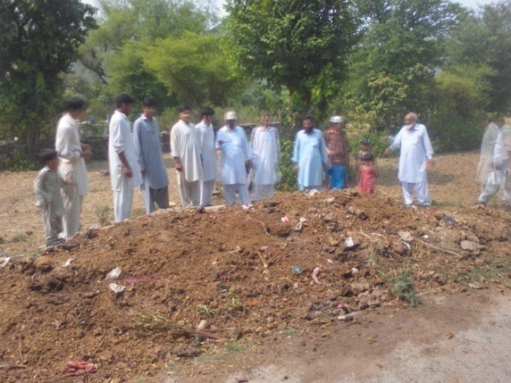
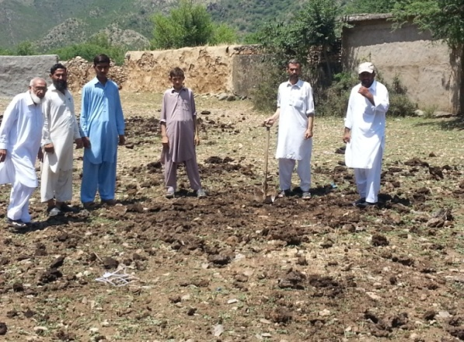
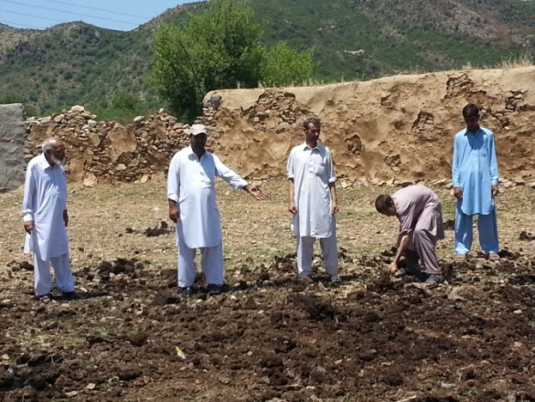
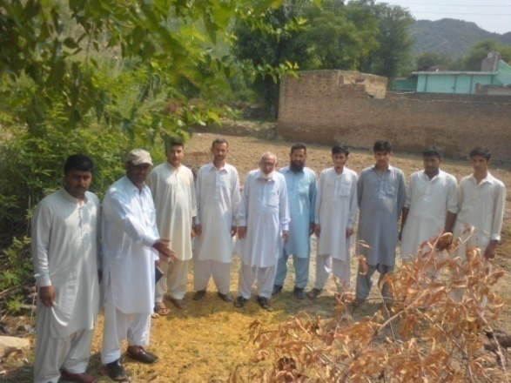
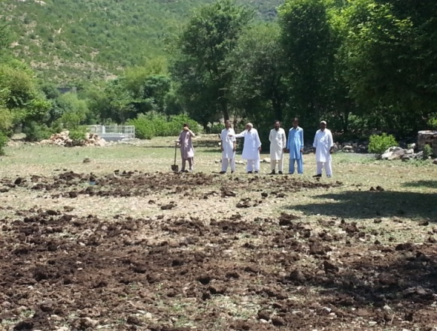
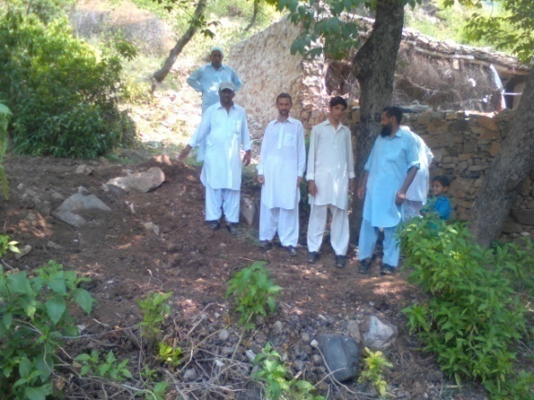
Training Session-Welcome address & Introduction of MAAN Project at village Sar Kachi Beer UC dated 12th July 2016
Notes:
1. Compost making Training at village Sar Kacchi on dated 12th and 13th July 2016

Slide 12
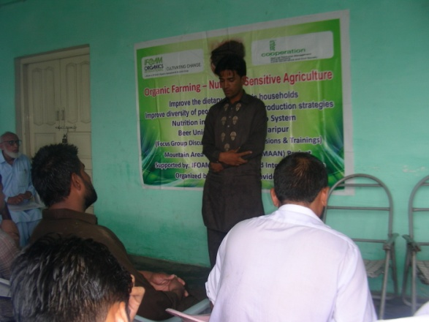
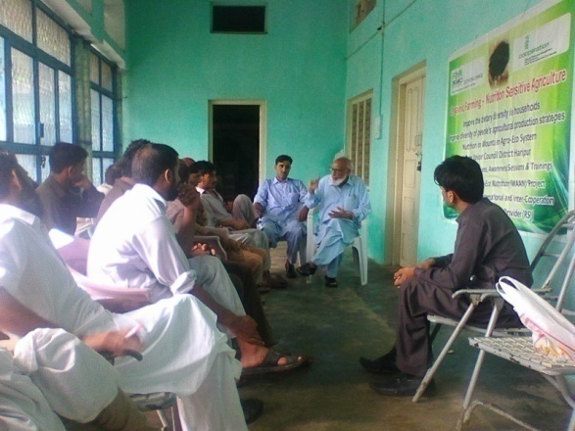
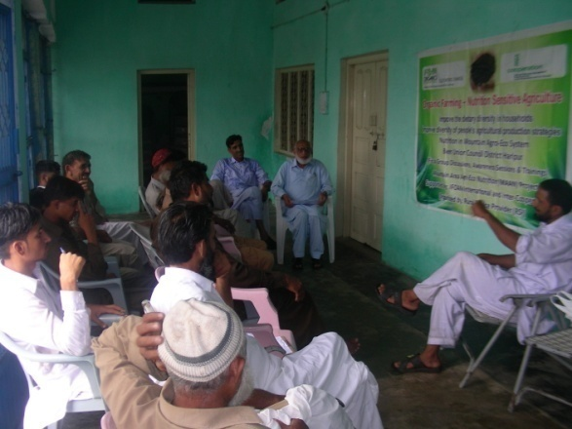
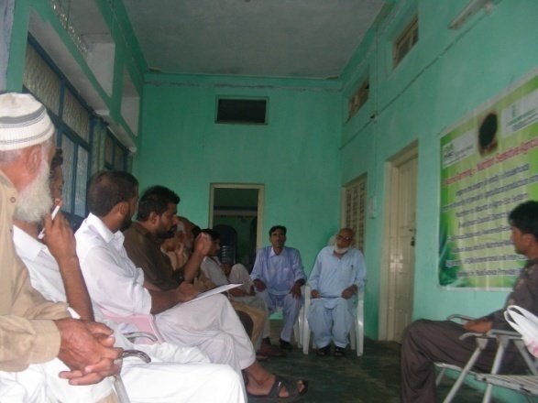
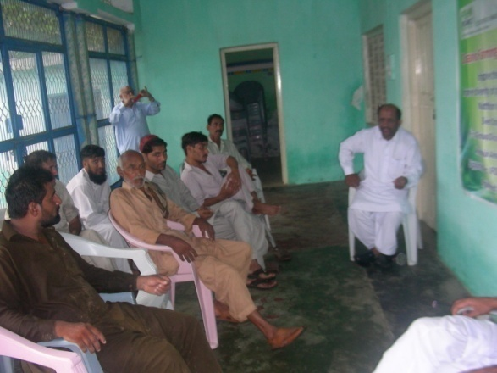
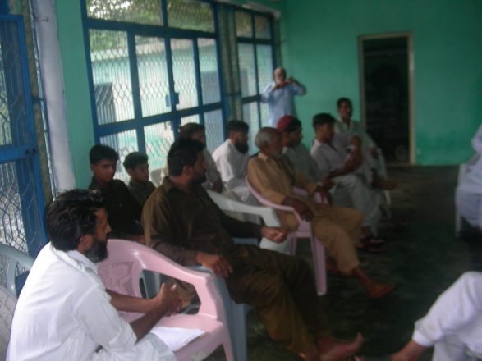
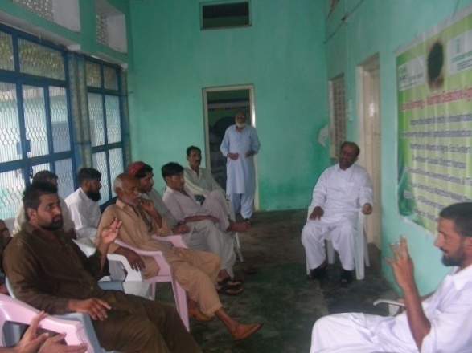
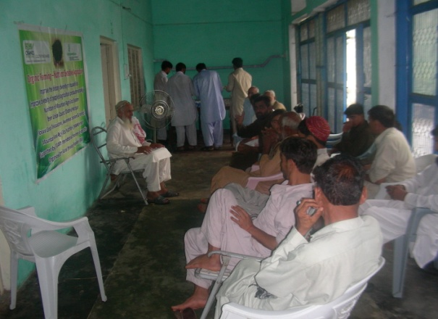
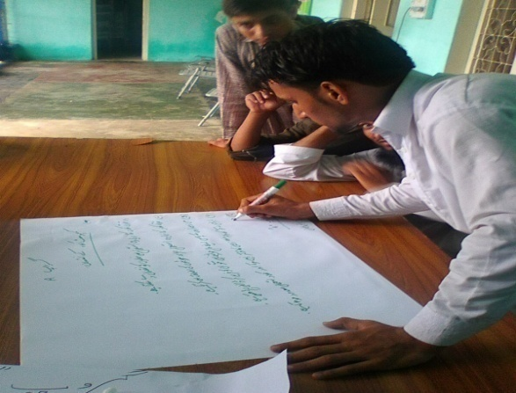
Notes:
2. Compost making Training at village Chinjiala cum Kacchi on dated 27th and 28th July 2016

Slide 13
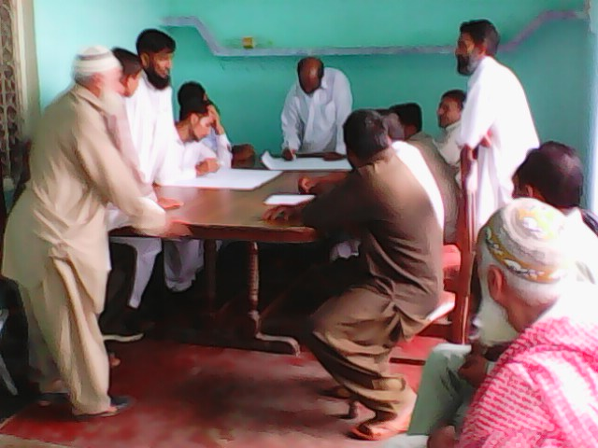
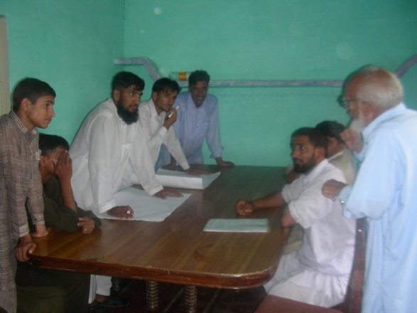
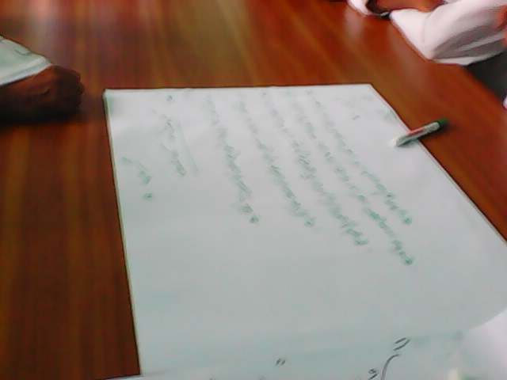
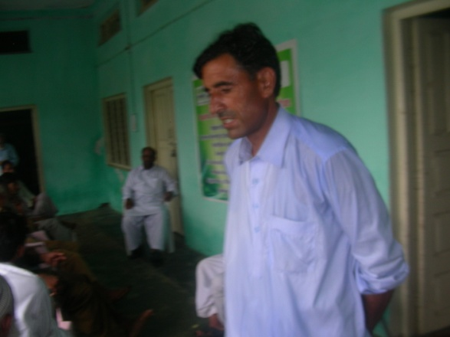
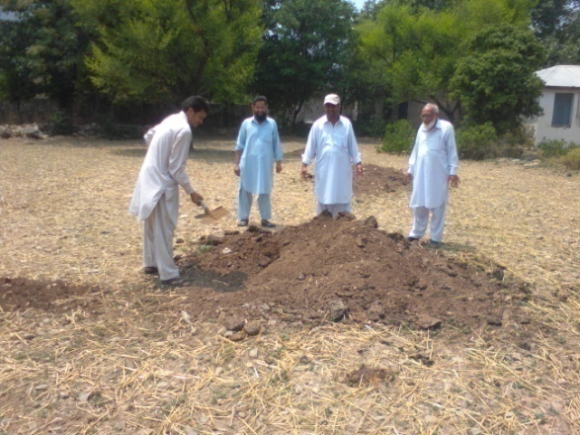
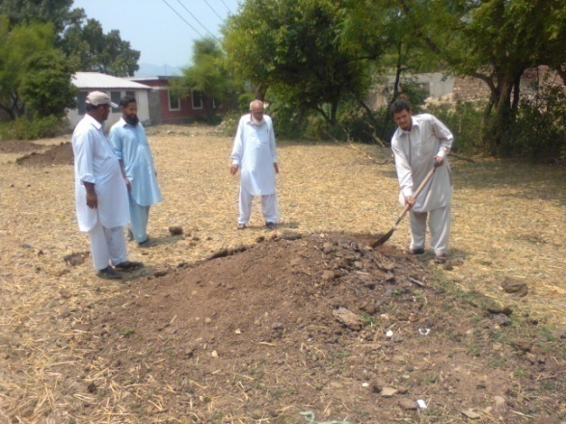
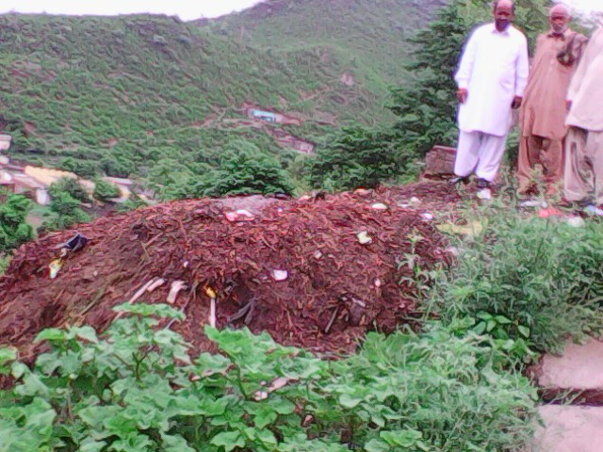
Notes:
Contnued- Compost making Training at village Chinjiala cum Kacchi on dated 27th and 28th July 2016

Slide 14
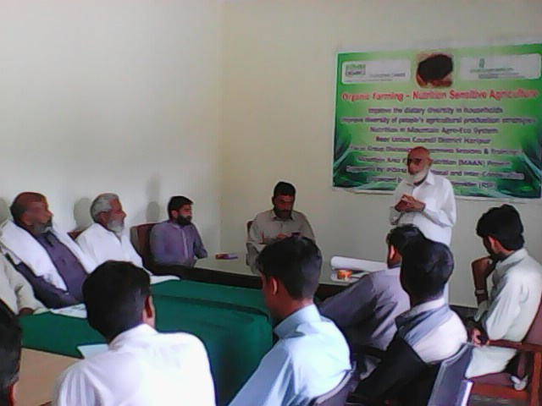
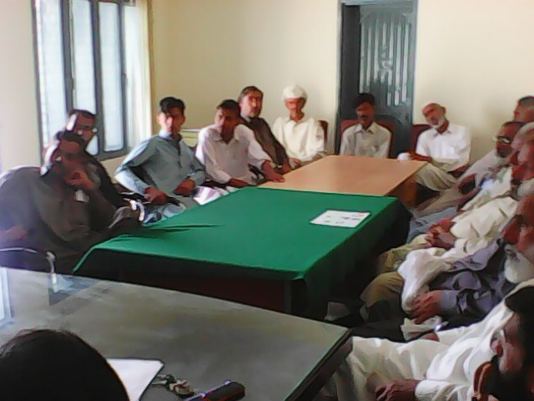
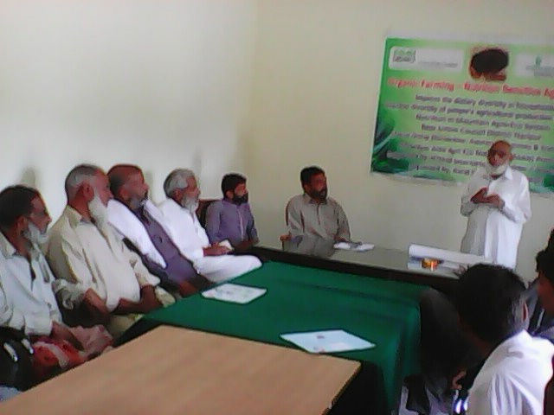
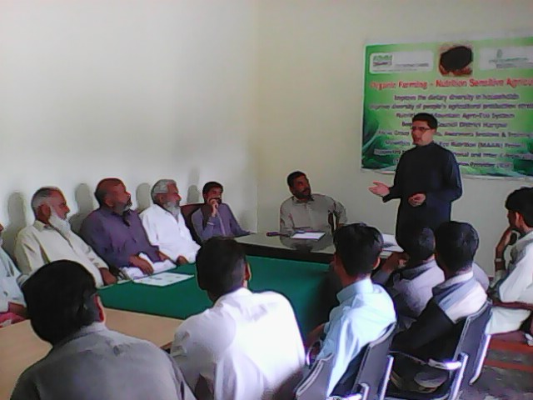
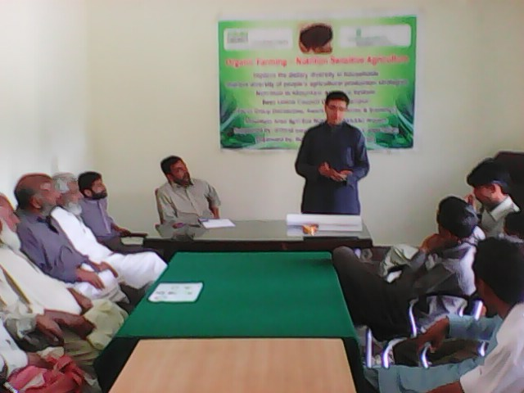
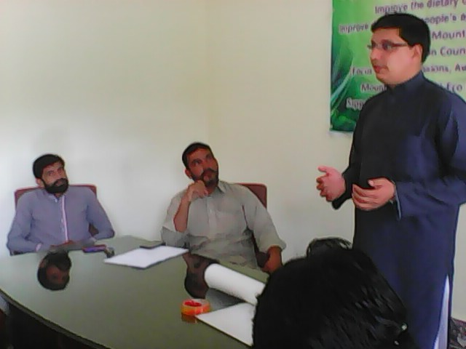
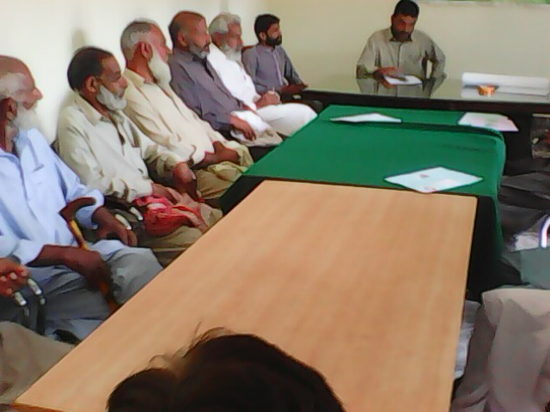
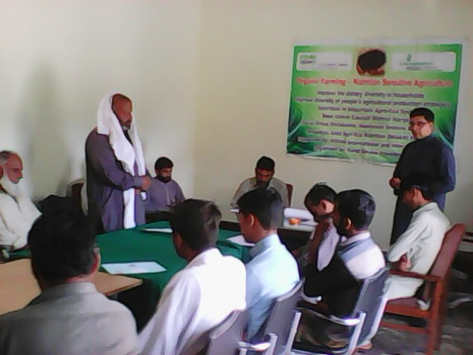
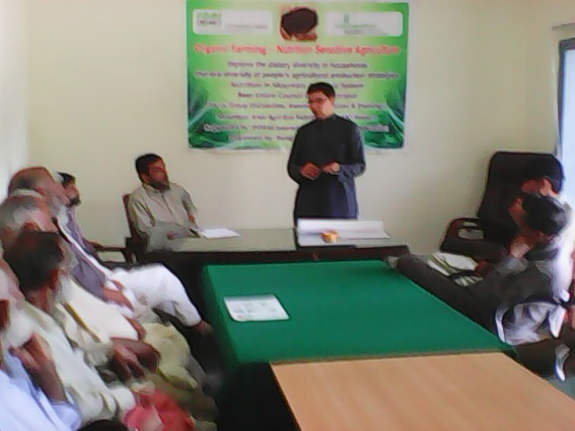
Notes:
3. Compost Making Training at Village Soha Beer Union Council- dated 21st and 22nd October 2016

Slide 15
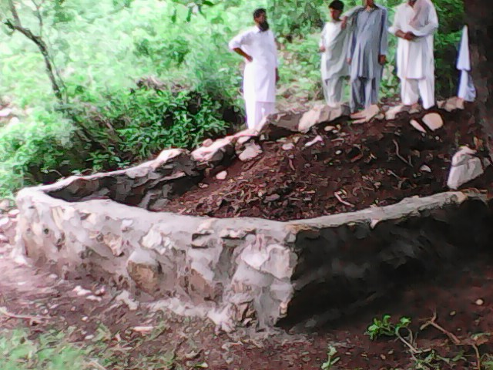
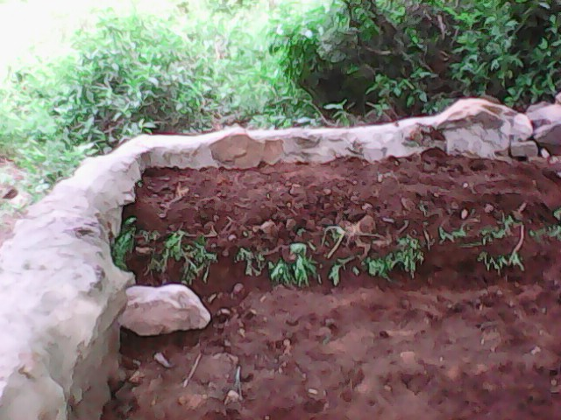
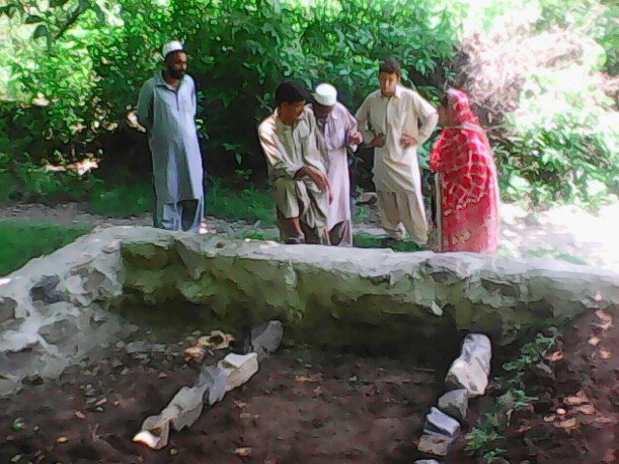
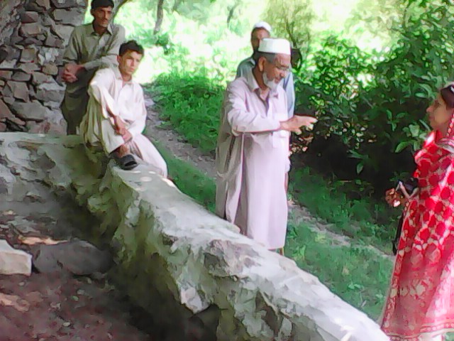
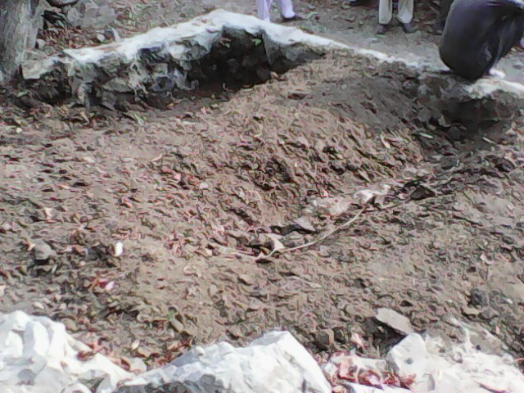
Notes:
1. Compost making site at village Zain Kacchi in the land of Babar Khan Farmer completed on dated 30th July 2016

Slide 16
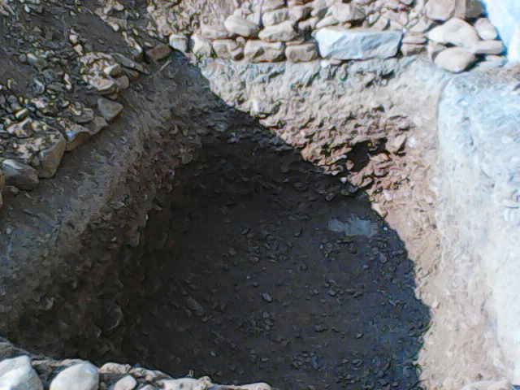
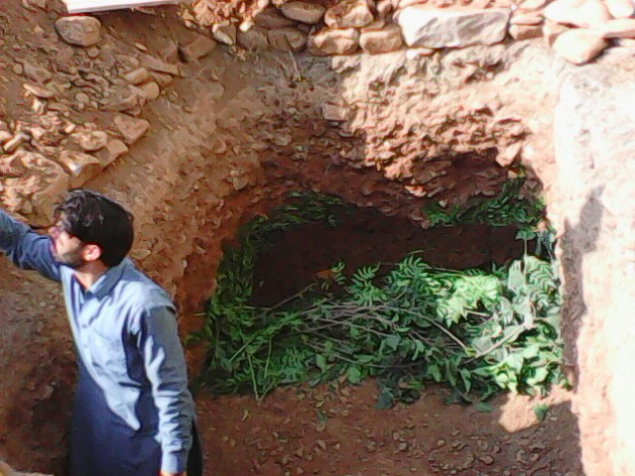
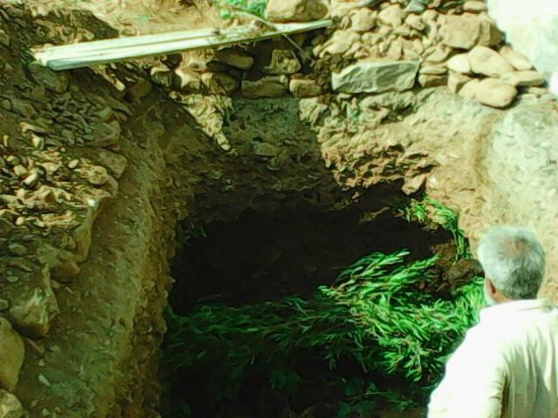
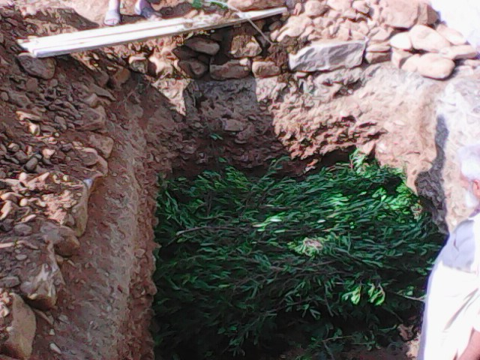
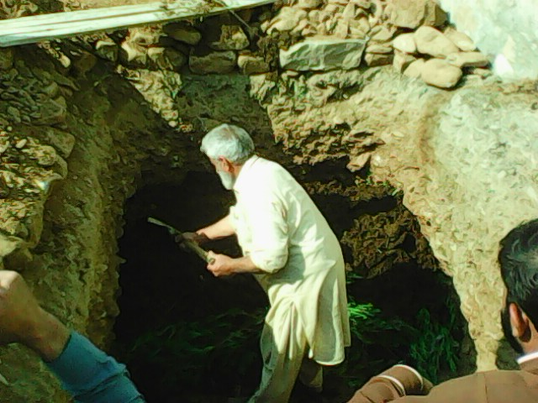

Notes:
2. Compost making site Soha in the land of M. Irshad Farmer completed on 04.11.2016

Slide 17






Notes:
Compost making site Jinjiala-cum Kacchi in the land of M. Haroon Farmer completed on 30.07.2016

Slide 18



Notes:
1. Compost Making Training / Display at Village Soha Beer Union Council- dated 28.11.2016

Slide 19









Notes:
Continued-Compost Making Training / Display at Village Soha Beer Union Council- dated 28.11.2016

Slide 20






Notes:
2. Compost Making Training / Display at Village Zain Kacchi Beer Union Council- dated 29.11.2016

Slide 21





Notes:
3. Compost Making Training / Display at Village Chinjiala cum Kacchi Beer Union Council- dated 30.11.2016

Slide 22
THANK YOU

